Slide 1
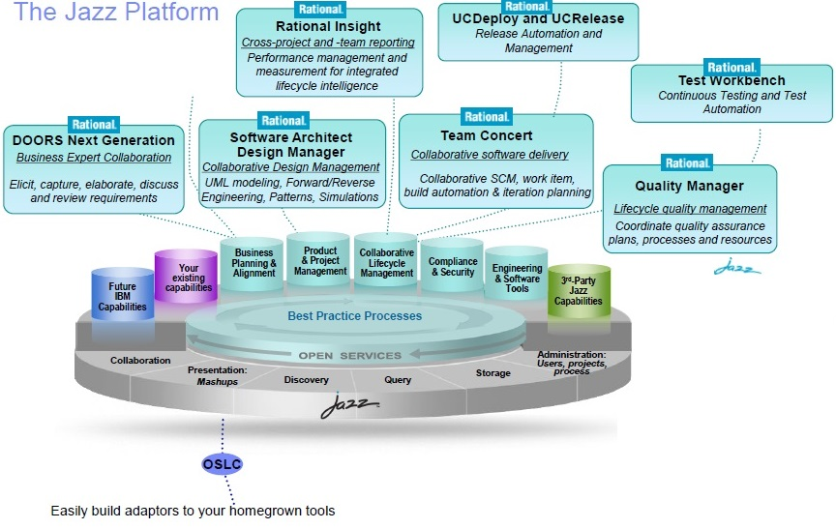
IBM Rational Products

Slide 2
IBM Rational Products Charge back Mechanism

Slide 3
IBM Tools Utilization
TechM Internal Top 10 Projects
PoC

Slide 4
Current Engagements

Slide 5
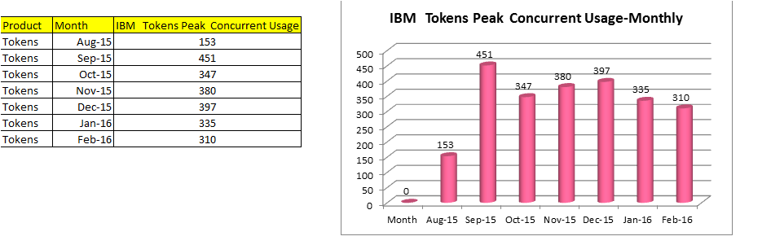
IBM Tools Utilizations Report

